Slide 2
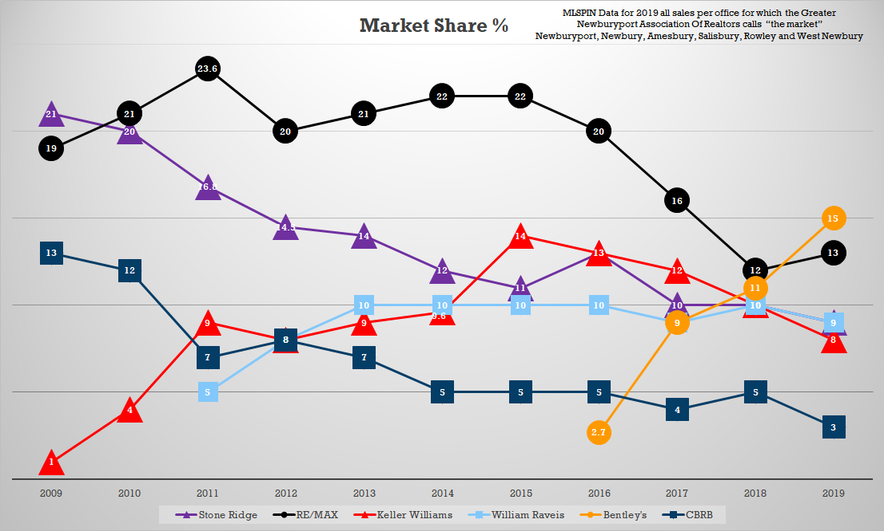

Slide 3
MARKETING TECH THAT NOT EVERYONE HAS
With 1.2 million agents in The U.S., only 1/1500 agents has access to this marketing technology

Slide 6
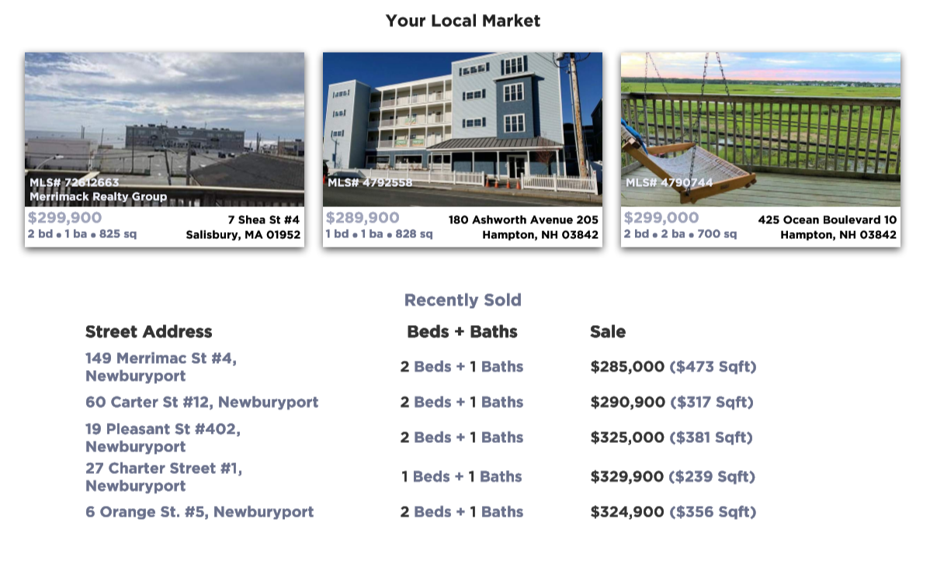

Slide 7
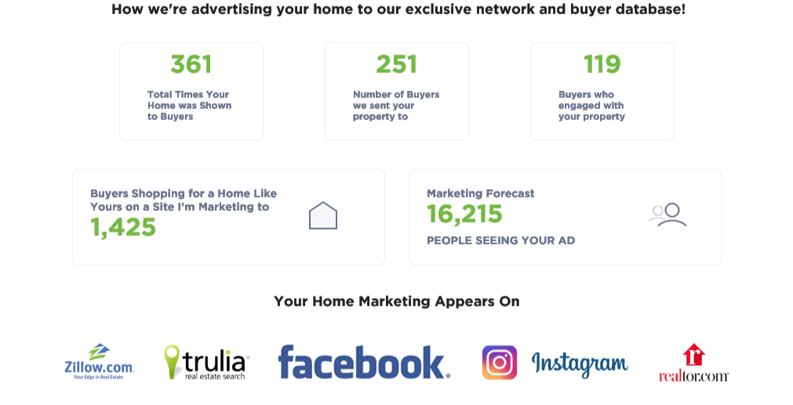

Slide 10
